Slide 1


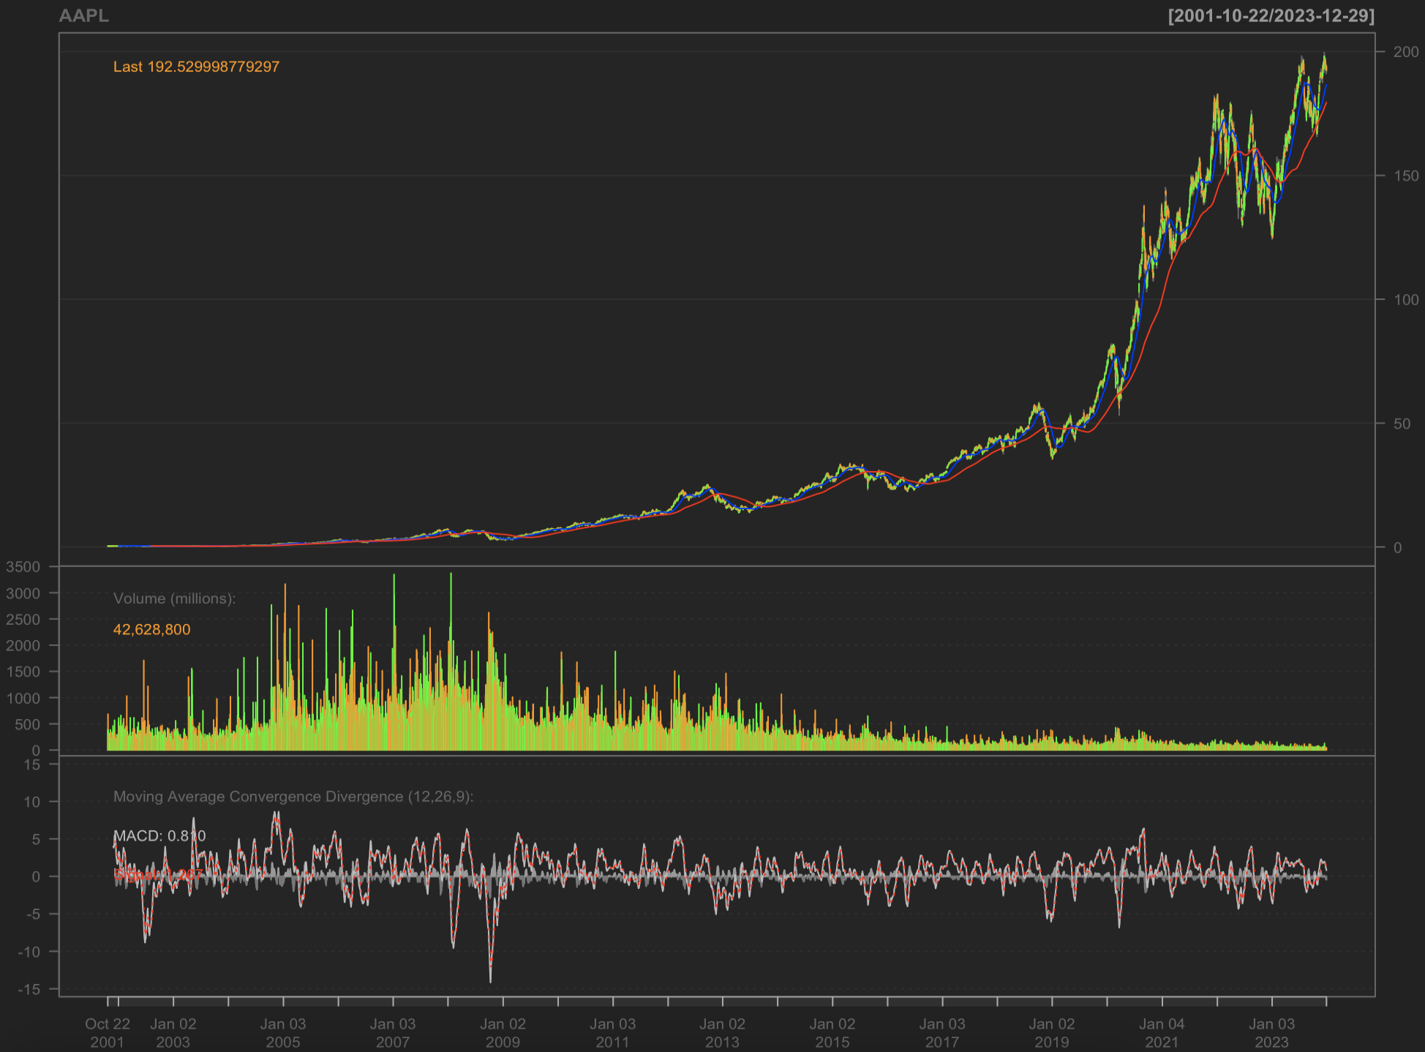
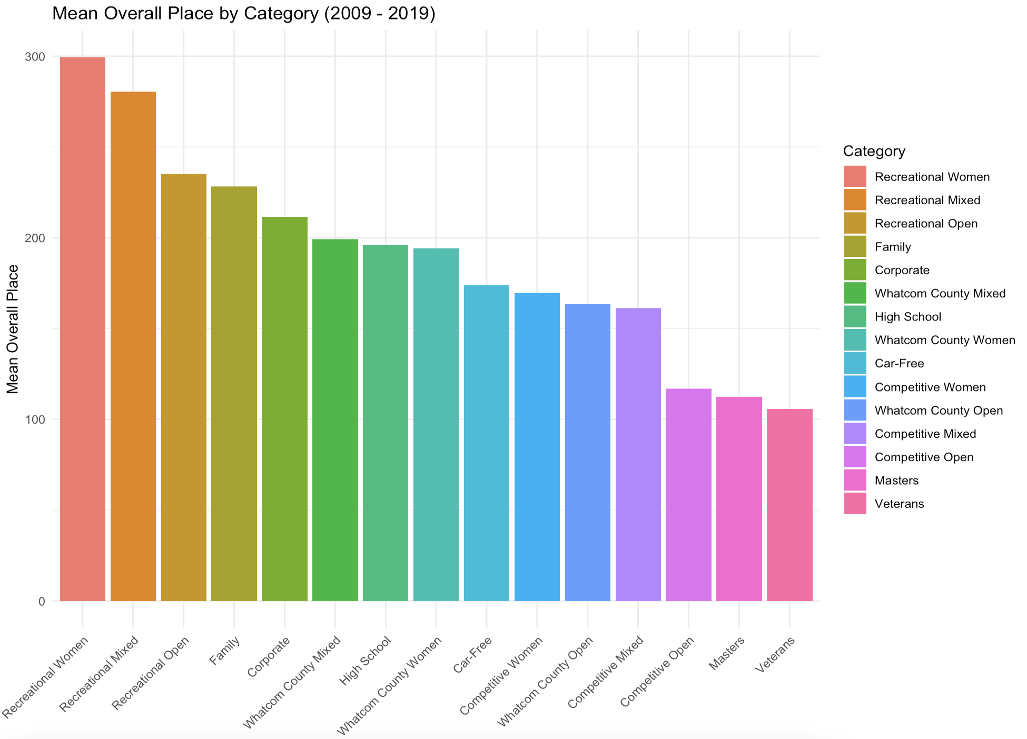
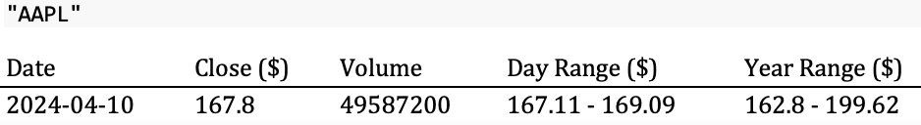
Web-Scraping: Generating Investment Pitches & Collecting Sports Data
Sam Peacock ‘24 (Statistics & Economics) – Advisor: Dr. Ivan Ramler
St. Lawrence University – Department of Mathematics, Computer Science, and Statistics
Goals
Report Generator
Collecting Sports Data
Use quantmod and Shiny packages to create an interactive, user-friendly web app that scrapes financial data from the web and generates simple investment pitches based on templates from SLU’s Crown Royalties Investment Club.
Use rvest to automate the collection of 10 years’ worth of results from each leg of the Ski to Sea race for SCORE.
Quantmod Charts
What is Ski to Sea?
Annual multi-sport relay race consisting of 7 legs
Events represent years and legs represent each sport
Pulling and combining 80 webpages of data for SCORE
Manually Scraping Data
Get a list of URLs for each leg of each race:
base_url <- “https://skitosea.pacificmultisports.com/events/101/results/leg/1”
2) Loop to attach year: event <- 101, 102, … , 111
3) Loop to get each sport: leg <- 1, 2, … , 80
4) Loop to attach and get every race URL:
url <- paste0(base_url, event, "/results/leg/", leg)
This example chart from the report displays Apple’s stock price history with Bollinger bands, SMAs, and MACD from a specified date range:
Generating Investment Pitches
What is Crown Royalties Investment Club (CRIC)?
The members of CRIC manage a $150,000+ portfolio. The club aims to educate students on the foundations of investing in weekly deliberations ran by executive board members and faculty advisors.
How do we use pitches?
Students present investment pitches with various analyses and propose to buy or sell a position for the portfolio.
Generating Investment Pitches
Quantmod develops and deploys statistically based trading models with the getSymbols function that internally scrapes historical stock price data from a specified online source and date range:
Apple’s stock price data ($AAPL) is now available for various statistical modeling visualizations that are transferred into a web app that generates downloadable investment reports.
Combine data:
Scrape for all data
Clean and format data
Save into one file
Linking Web App and Report
Create the Shiny App (app.R)
Define the UI and server elements in a single file
Create the R Markdown File (report.Rmd)
Use R code chunks to include dynamic data
Link Shiny App to R Markdown File
Use the rmarkdown::render function to render the report.Rmd with the inputted dynamic data from the app.R
Add a “Generate Report” Button
Use the eventReactive function in Shiny to render the report.Rmd into a downloadable word document
Manually Web-Scraping Financials
Incorporate manual web-scraping techniques to harvest financial data for more comprehensive reports.
Stock price history is essential for technical and statistical analyses; however, extracting data from the three financial statements would provide further due diligence to make a more informed investment decision with financial health analyses and various valuation methods.

